Slide 1
Advanced Database
Maziar Shajari
last revised: Summer 2020

Slide 2
Course Plan (Part I)
Class rules & Syllabus
Resources
Database introduction (Platform installation)
Videos

Slide 3
From instructional plan:
Assignment 1 | 10%
Assignment 2 | 10%
Assignment 3 | 10%
Assignment 4 | 10%
Test 1 (Midterm) | 30%
Test 2 (Final) | 30%
Instructor:
Name: Maziar Shajari
Email: Maziar.Shajari@Georgiancollege.ca
WEEK | LESSON |  | DUE
1 | Database Fundamentals Review – Installing SSMS – Adding External Sample Databases
2 | Database Installation - SELECT Statement
3 | Advanced Select – Simple scalar functions - Standards | Assignment 1 - 10% | Week 4
4 | Relationships - Join tables – basic Joins and Outer Join
5 | Using the Subqueries & CTE | Assignment 2-10% | Week 6
6 | CRUD Commands – Create, Read, Update, Delete
7 | Mid-Term Exam | 30%
- | Study Week
8 | Database Design, More Updates, Transaction Statements (Rollback)
9 | Database Design (Cont.) – Transactions (Commit and multiple transactions) | Assignment 3-10% | Week 10
10 | Database constraints – Data Types
11 | Triggers – Views – Aggregate Functions | Assignment 4-10% | Week 12
12 | Store Procedures & User Define Functions
13 | Final Exam | 30%

Slide 4




What is SQL?
SQL stands for Structured Query Language, which is the standard language for working with a relational database.

Slide 5

History of Databases
https://www.youtube.com/watch?v=KG-mqHoXOXY&list=PLxnkEN-mxAXYyPen404ccEpV37xPWYN3t&index=23
5’:19”

Slide 6
Database Examples:
Reservations Dry Cleaner
Google Search
IMDb
High Score on Video Game
Student Loan
iPod Playlist
Bank Accounts
Phone Bill
Credit Card
Library Card
Hotel
…
CAN YOU ADD MORE?

Slide 7
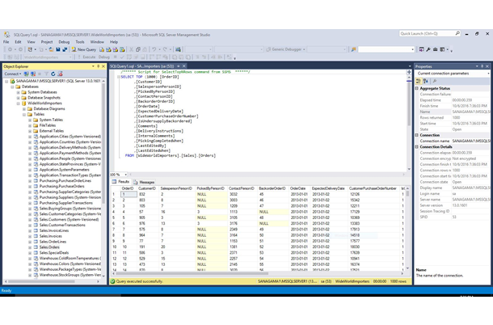
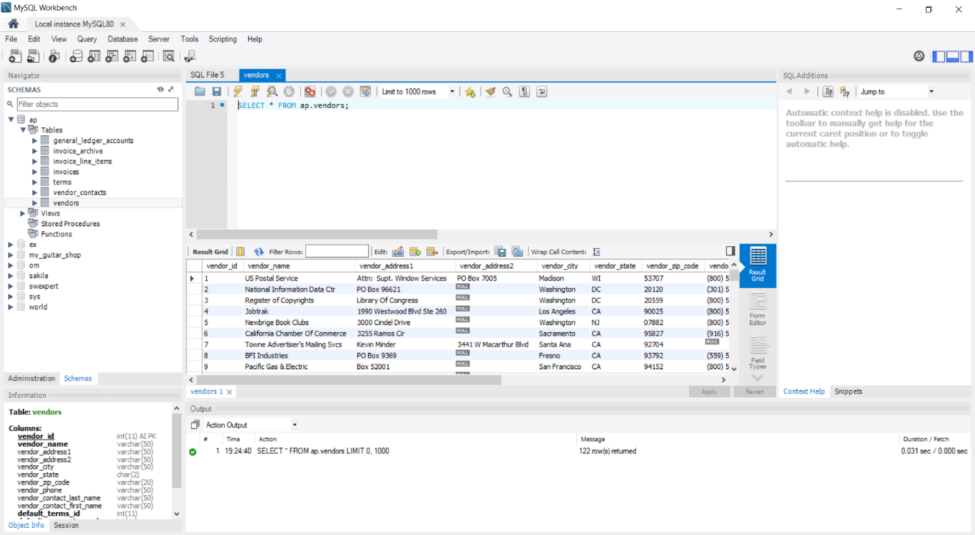
Two famous SQL platforms:
MS SQL
MySQL Workbench

Slide 8
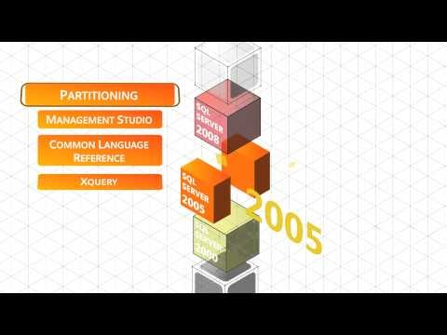
SQL History

Slide 9
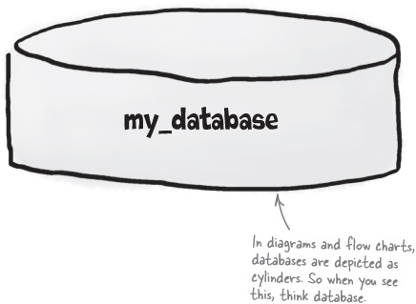
Data Base Definition
A Database is an organized collection of data.
A Database is a container that holds tables and other SQL structures related to those tables.
Database Management System (DBMS)
RDBMS is the basis for SQL, and for all modern database systems such as MSSQL Server, IBM DB2, Oracle, MySQL, and Microsoft Access.
We are going to focus on
MS - SQL

Slide 10
Is the Figure clear to explain?

Slide 11
Hardware Components
The three hardware components of a client/server system
Clients
Server
Network
Terms to know
Local area network (LAN)
Wide area network (WAN)
Enterprise system

Slide 12
Table example:
The information inside
the database is organized
into tables.

Slide 13
A networked system that uses an application server

Slide 14
MSSQL 2012 Editions
SQL Server 2012 comes in five edition:
Express Edition
Developer Edition
Standard Edition
BI or Business Intelligence
Enterprise Edition
Almost same features
Free to use by students

Slide 15
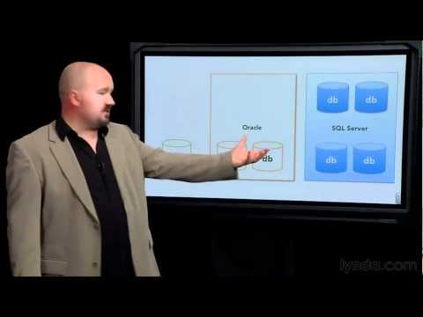
Understanding the core components of SQL Server | lynda.com overview
9’:12”

Slide 16
SQL Server Installation – Hands on
Click to Visit the website
The SQL Server Installation Wizard provides a single feature tree to install all SQL Server components:
Database Engine
Analysis Services
Reporting Services
Integration Services
Master Data Services
Data Quality Services
Connectivity components
https://docs.microsoft.com/en-us/sql/database-engine/install-windows/installation-for-sql-server?view=sql-server-2017

